Slide 1
ILLUSIONS

Slide 2
Menu:
What is an illusion?
Illusion of length
Illusion of shape
Illusion of size
Illusion of touch
Illusion of temperature

Slide 3
What is an illusion?
Illusion, a mistake in the perception of a sensory experience. An illusion occurs when what the brain perceives differs substantially from the actual qualities of an object or stimulus. Illusions may occur in any of the human senses, including vision, hearing, touch, smell, and taste.

Slide 4
However, errors in perception are only considered illusions if they are experienced by a large number of people. For example, if you are the only person who misreads a word, that is not an illusion. But if a large number of people misread the word in exactly the same way, then it may be considered an illusion.

Slide 5
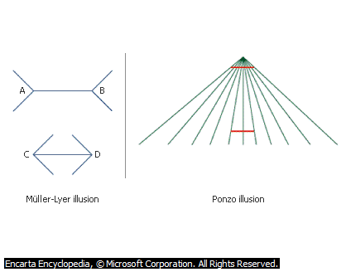
Illusion of length

Slide 6
The first illusion is probably the most famous and most studied illusion in psychology—the Müller-Lyer illusion, created by German psychiatrist Franz Müller-Lyer in 1889.
The second illusion is called the Ponzo illusion, named after Italian psychologist Mario Ponzo.

Slide 7
Explanation to Müller-Lyer illusion: Because we take distance into account when judging size, if two objects project the same image size on the retinas of our eyes, we interpret the object that seems farther away as larger.

Slide 8
The explanation for second illusion also involves depth perception. You interpret the oblique lines as indicating depth, which leads you to perceive the upper horizontal line as farther away than the bottom line. Although the images formed on your retinas by the two horizontal lines are actually equal in length, you perceive the upper line as longer because you think that it is farther away.

Slide 9
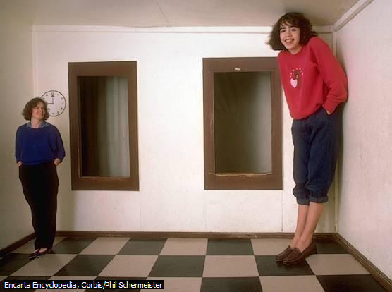
Illusion of size

Slide 10
This unusual room is called the Ames room after American ophthalmologist Adelbert Ames, who first constructed such a room in the 1940s.

Slide 11
The room itself is constructed in such a way that it provides misleading cues about distance. The left corner of the room is actually farther away from the viewer than the right corner of the room. In addition, the right side of the room is elevated so that the feet of both people appear at roughly the same relative height on the visual field.

Slide 12
Illusion of temperature
A person puts one hand in a bowl of cold water and the other hand in a bowl of hot water, and allows both hands to adjust until the sensation of temperature disappears.

Slide 13
If the person then plunges both hands into lukewarm water, the hand that had adapted to the hot water feels cold in a lukewarm water, whereas the hand that had adapted to the cold water feels warm in the same water. This shows that the skin’s perception to temperature is relative, but not absolute. (by John Locke)

Slide 14
Conclusion
There still are disagreements on what exactly causes different illusions.
This field still needs researches.
Explanation of illusions lead to understanding perception.

